Slide 1
3-Player Kuhn Poker – Reinforced Learning
Tobechukwu Ezewike

Slide 2
Reinforcement Learning in Games
In reinforcement learning, an agent adjusts its actions based on its performance in previous situations.
There are four main elements to reinforcement learning in game theory:
Model – Mimics the behavior of the game’s environment
Policy – Defines the agent’s way to behave at a given state
Reward Function – Defines the goal of the agent, usually represented as payoffs
Value Function – Defines which action will be most desired from the agent from a given state.

Slide 3
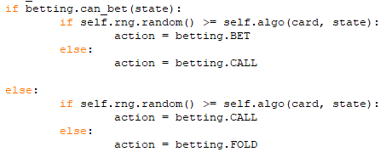
Overview of My Agent
Programming Language – Python using the library linked to by the professor.
Model – The code models 3-Player Kuhn Poker
Policy – The agent, given a choice of two actions, will choose action[0] with a probability determined by the value function.

Slide 4
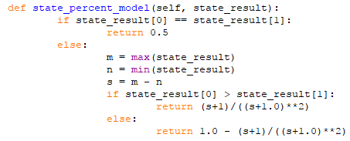

Overview of My Agent
Reward Function – This was simply the amount lost or gained from a state and the agent’s corresponding action.
Value Function –The value function was equal to the base odds given some card of a certain value multiplied by a model representing the odds the agent should pick action[0] versus action[1].
$\lim_{dist→∞}\left(\frac{dist+1}{{\left(dist+1\right)}^{2}}\right)=0$

Slide 5
References
Yifie Wang. Learning in 3-Player Kuhn Poker. University of Manchester. Online PDF. http://studentnet.cs.manchester.ac.uk/resources/library/3rd-year-projects/2015/yifei.wang-6.pdf
Richard S Sutton and Andrew G Barto. Introduction to reinforcement learning. MIT Press, 1998.

